Slide 1

YEONTANDER PROVIDER
Group 5
2SC4

Slide 2
Member :
Juana Lucia Raharusun
Muhamad Farhan Aldisyah Putra
Pratistha Cahya Kancana
Faculty :
Kevin Harada

Slide 3
TABLE OF CONTENTS
01
SYSTEM ANALYSIS
02
HTML PAGES
Explain about system that we used.
Describe the webpages in Yeontander.

Slide 4
01
SYSTEM ANALYSIS

Slide 5
SYSTEM ANALYSIS
An internet provider is a service provider that provides internet connection services in the field of cellular telecommunications.
This website was created to make it easier for customers to purchase credit and internet packages.
To make the website look more attractive and presentable, we use CSS that is connected to the HTML page.

Slide 6
02
HTML PAGES

Slide 7
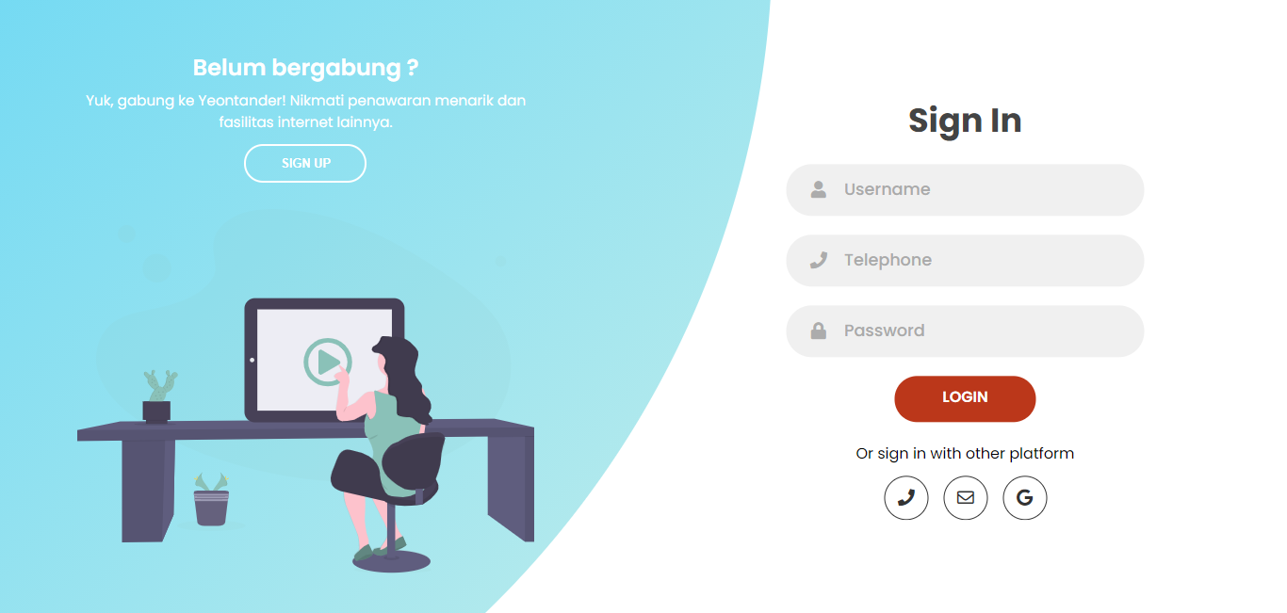
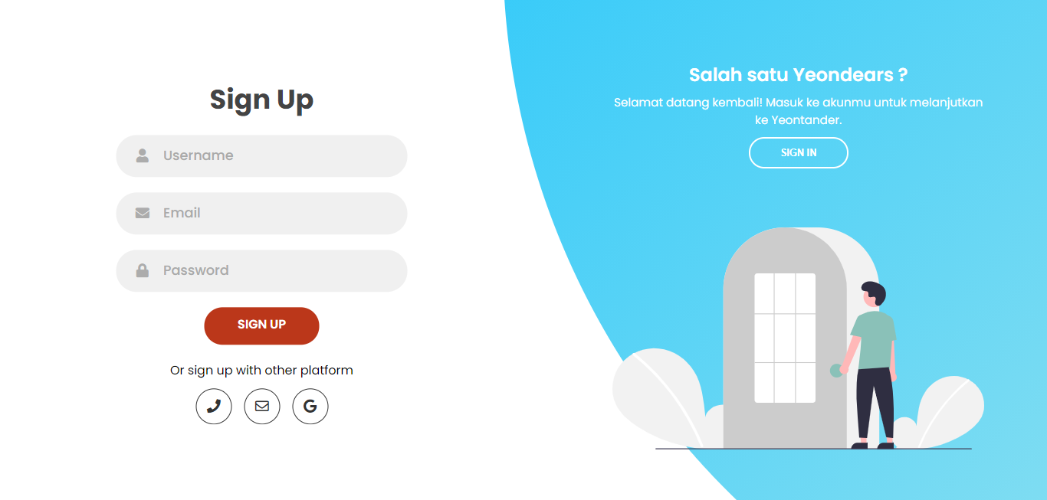
SIGN IN & SIGN UP
Meanwhile, for those who do not have an account, you can create an account first by entering your username, email, and password.
Customers who already have an account can directly login by entering their username, phone number, and password.

Slide 8
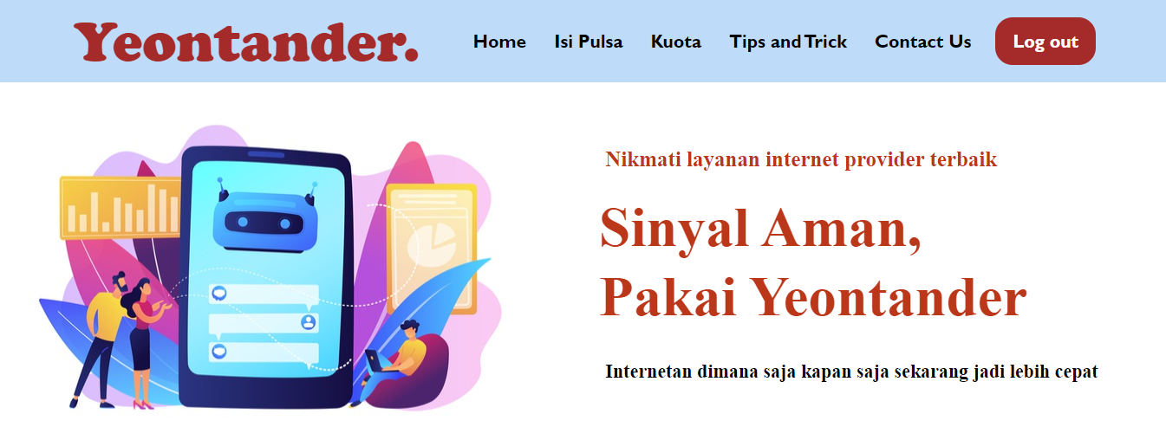
H O M E
Ithere is a menu bar consisting of 6 section and a brief description of Yeontander Provider

Slide 9
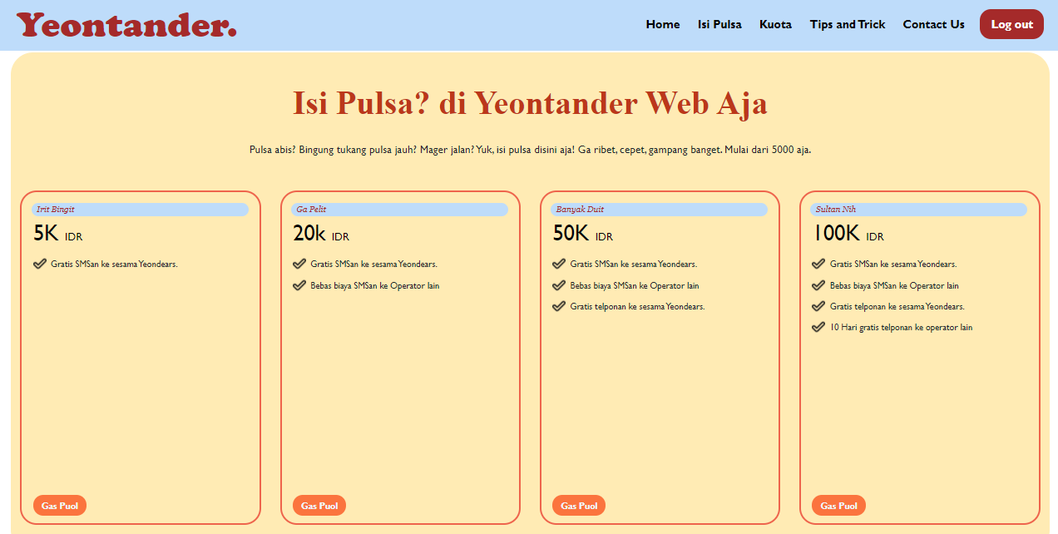
I S I P U L S A
We provide 4 credit options namely Irit Bingit, Ga Pelit, Banyak Duit,
and Sultan Nih. With the advantages of each option and there is a button that will lead to the payment form.

Slide 10
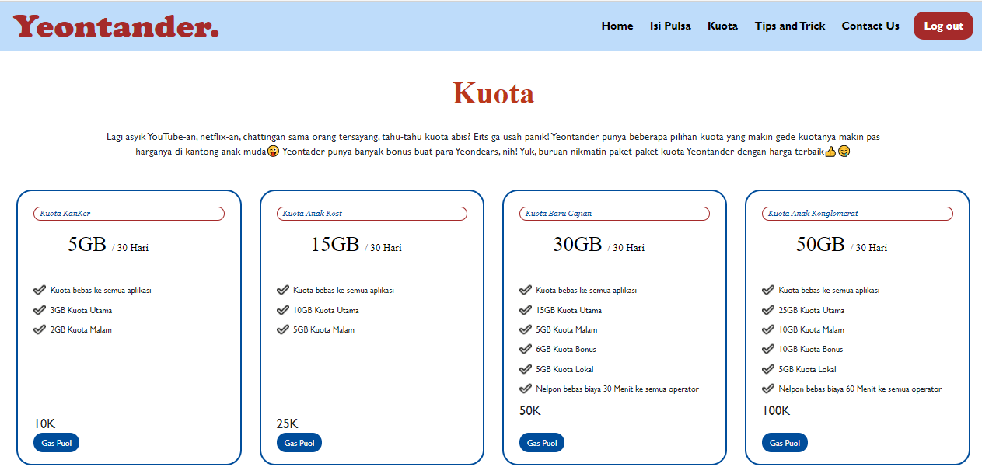
K U O T A
In the Kuota section there are also 4 options with the benefits of each choice..
After selecting, the customer can click the button that will lead to the payment form.

Slide 11
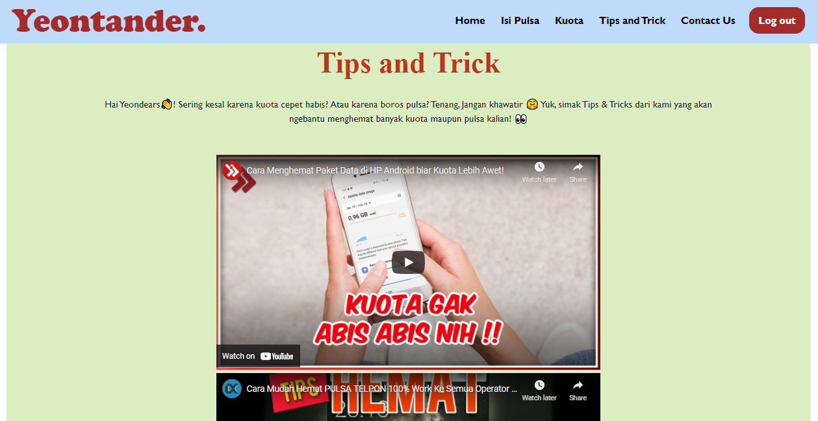
T I P S & T R I C K S
Yeontander provides some tips that will be useful for customers.

Slide 12
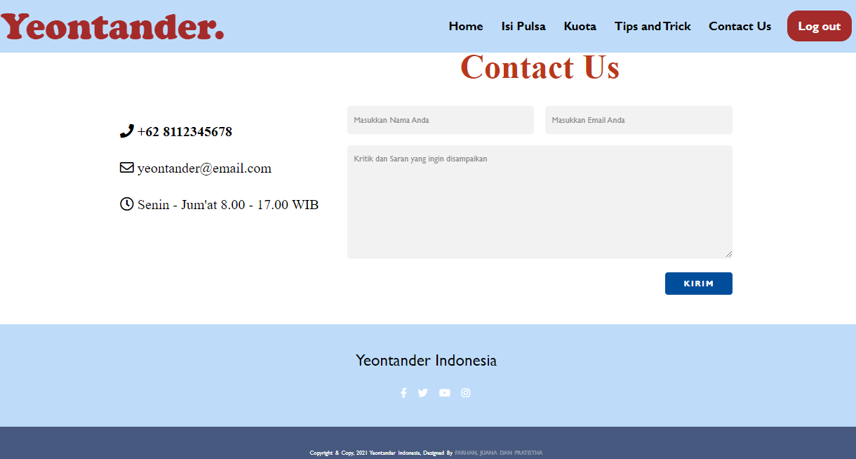
C
O
N
T
A
C
T
U
S
We provide special field for customer to submit their criticism and sugggestion. We also include an email and telephone that can be contacted by customer

Slide 13
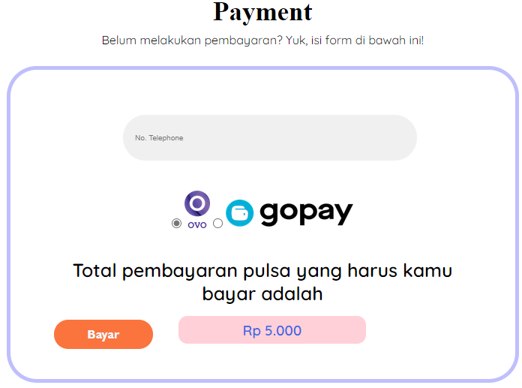
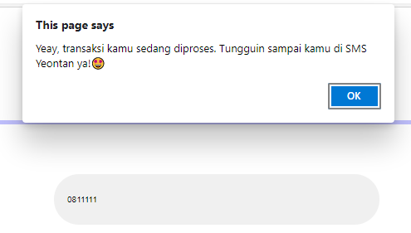
P A Y M E N T
In the form the customer needs to fill in the phone number and needs to choose a payment method. There's also a pop up message that notifies that the transaction is being processed.

Slide 14
T H A N K Y O U

